Slide 1
Unit-2
Linear Models for Regression and Classification

Slide 2
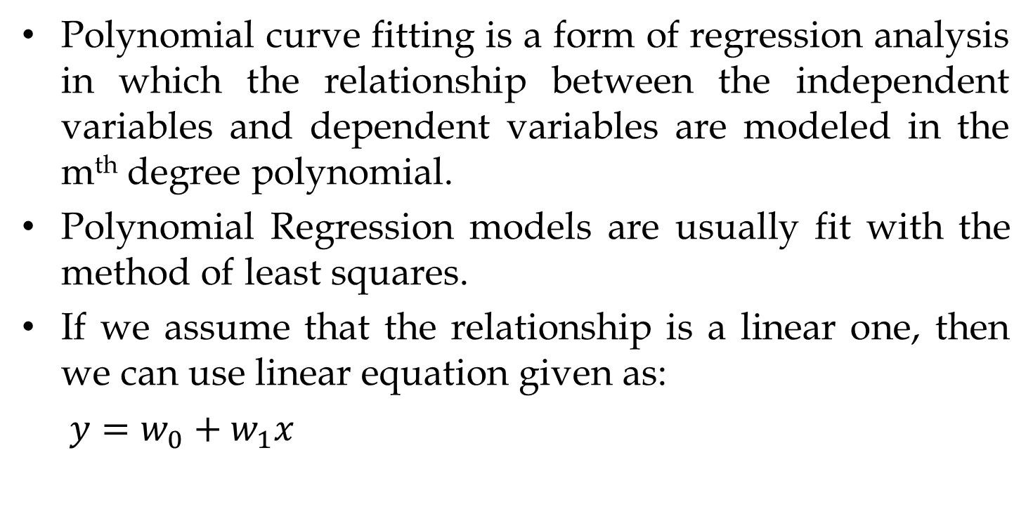
Polynomial Curve Fitting
Polynomial curve fitting is a form of regression analysis in which the relationship between the independent variables and dependent variables are modeled in the m^{th} degree polynomial.
Polynomial Regression models are usually fit with the method of least squares.
If we assume that the relationship is a linear one, then we can use linear equation given as:
$y=w_{0}+w_{1}x$

Slide 3
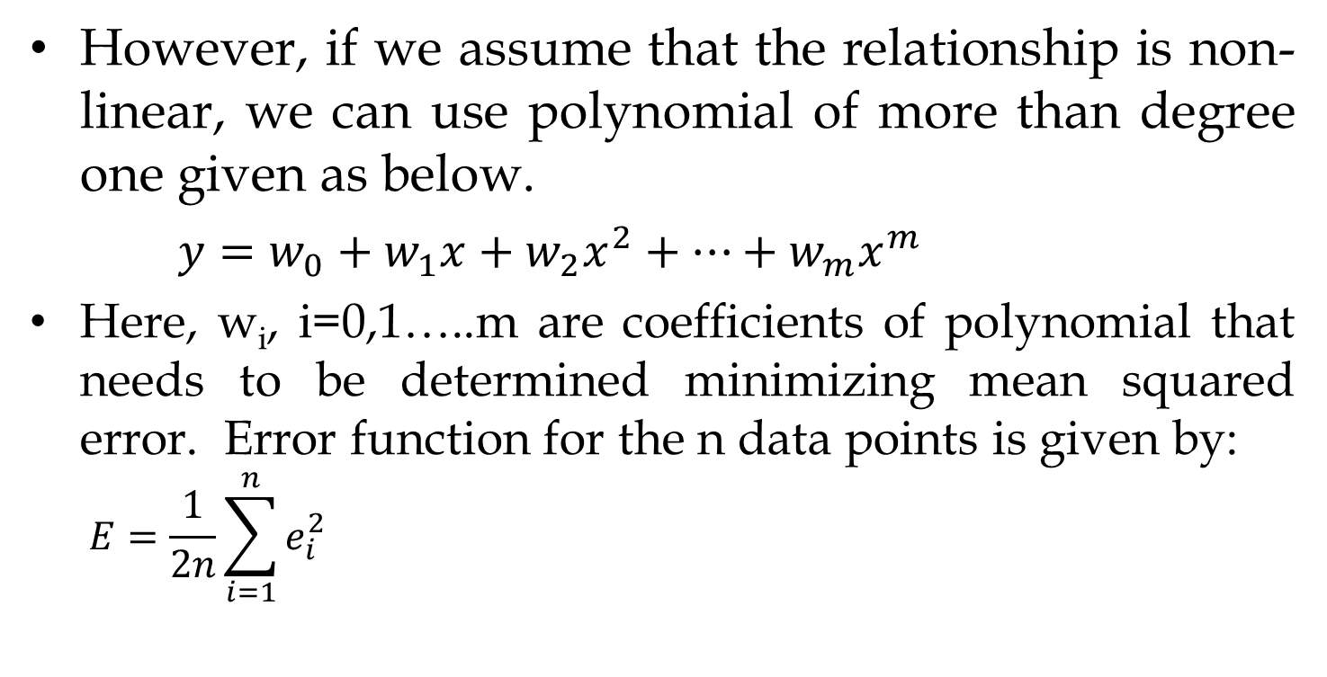
Polynomial Curve Fitting
However, if we assume that the relationship is non-linear, we can use polynomial of more than degree one given as below.
$y=w_{0}+w_{1}x+w_{2}x^{2}+…+w_{m}x^{m}$
Here, w_{i}, i=0,1…..m are coefficients of polynomial that needs to be determined minimizing mean squared error. Error function for the n data points is given by:
$$E=\frac{1}{2n}\sum_{i=1}^{n}{e_{i}^{2}}$$

Slide 4
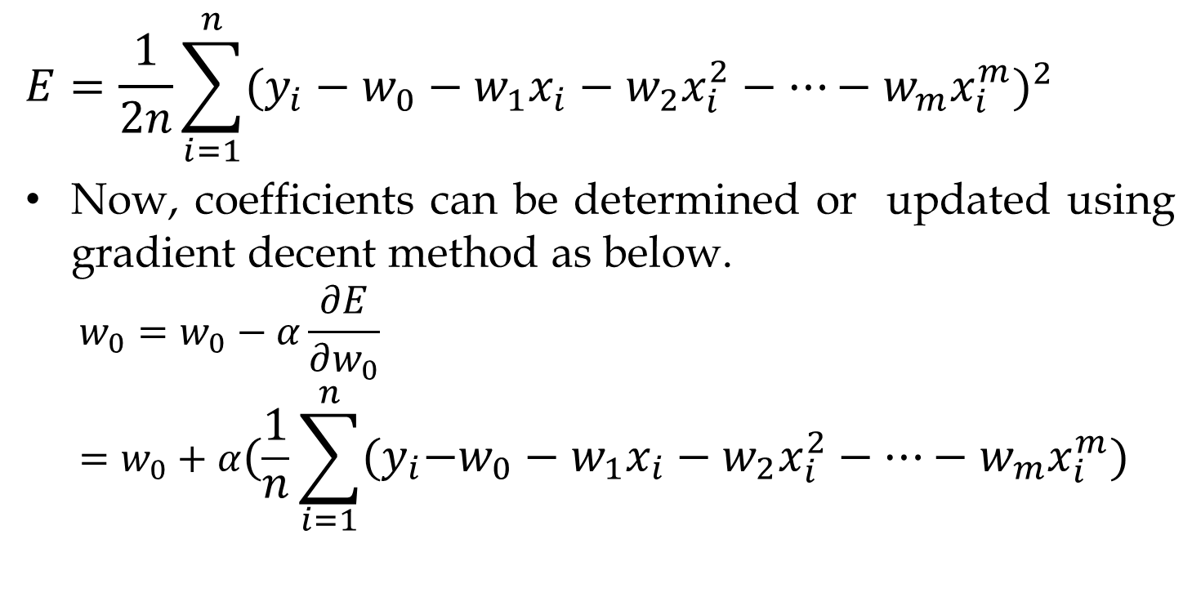
Polynomial Curve Fitting
$$E=\frac{1}{2n}\sum_{i=1}^{n}{{({y_{i}−w}_{0}−w_{1}x_{i}−w_{2}x_{i}^{2}−…−w_{m}x_{i}^{m})}^{2}}$$
Now, coefficients can be determined or updated using gradient decent method as below.
$$w_{0}=w_{0}−α\frac{∂E}{∂w_{0}} =w_{0}+α(\frac{1}{n}\sum_{i=1}^{n}{{{(y}_{i}−w}_{0}−w_{1}x_{i}−w_{2}x_{i}^{2}−…−w_{m}x_{i}^{m}})$$

Slide 5

Polynomial Curve Fitting
$$w_{1}=w_{1}−α\frac{∂E}{∂w_{1}} =w_{1}+α(\frac{1}{n}\sum_{i=1}^{n}{{{(y}_{i}−w}_{0}−w_{1}x_{i}−w_{2}x_{i}^{2}−…−w_{m}x_{i}^{m}})x_{i}$$
$$w_{2}=w_{2}−α\frac{∂E}{∂w_{2}} =w_{2}+α(\frac{1}{n}\sum_{i=1}^{n}{{{(y}_{i}−w}_{0}−w_{1}x_{i}−w_{2}x_{i}^{2}−…−w_{m}x_{i}^{m}})x_{i}^{2}$$
So on

Slide 6
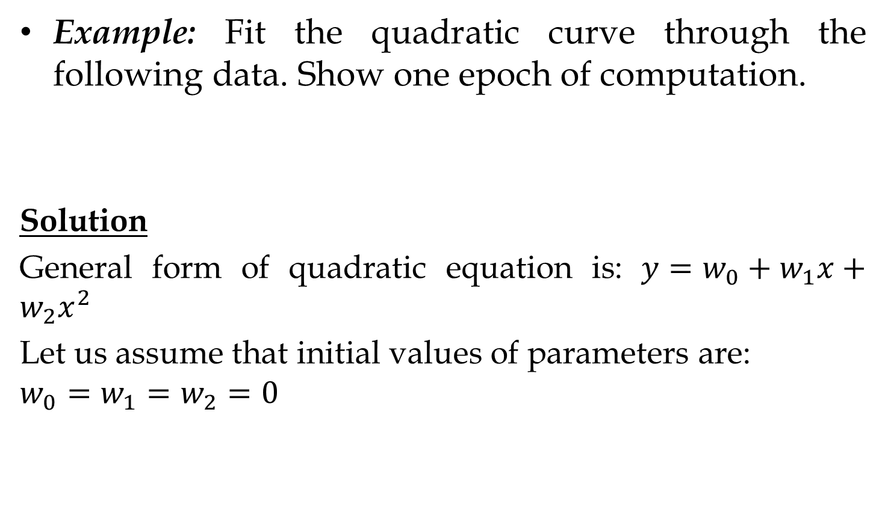
Polynomial Curve Fitting
Example: Fit the quadratic curve through the following data. Show one epoch of computation.
Solution
General form of quadratic equation is: $y=w_{0}+w_{1}x+w_{2}x^{2}$
Let us assume that initial values of parameters are:
$$w_{0}=w_{1}=w_{2}=0$$
X | 1 | 2 | 3 | 4
f(x) | 2 | 7 | 14 | 23

Slide 7
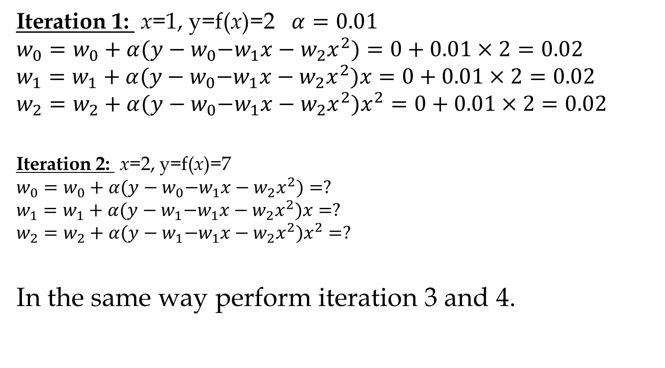
Polynomial Curve Fitting
Iteration 1: x=1, y=f(x)=2 $α=0.01$
$$w_{0}=w_{0}+α{(y−w}_{0}−w_{1}x−w_{2}x^{2})=0+0.01×2=0.02$$
$$w_{1}=w_{1}+α{(y−w}_{0}−w_{1}x−w_{2}x^{2})x=0+0.01×2=0.02$$
$$w_{2}=w_{2}+α{(y−w}_{0}−w_{1}x−w_{2}x^{2})x^{2}=0+0.01×2=0.02$$
Iteration 2: x=2, y=f(x)=7
$$w_{0}=w_{0}+α{(y−w}_{0}−w_{1}x−w_{2}x^{2})=?$$
$$w_{1}=w_{1}+α{(y−w}_{1}−w_{1}x−w_{2}x^{2})x=?$$
$$w_{2}=w_{2}+α{(y−w}_{1}−w_{1}x−w_{2}x^{2})x^{2}=?$$
In the same way perform iteration 3 and 4.

Slide 8
Logistic Regression
Logistic regression is one of the most popular machine learning algorithms for binary classification. This is because it is a simple algorithm that performs very well on a wide range of problems.
We want to predict a variable , where 0 is called negative class, while 1 is called positive class. Such task is known as binary classification.

Slide 9
Logistic Regression
The heart of the logistic regression technique is logistic function and is defined as:
Logistic function transforms the input into the range [0, 1]. Smallest negative numbers results in values close to zero and the larger positive numbers results in values close to one.
If there are two input variable, logistic regression has two coefficients just like linear regression.

Slide 10
Logistic Regression
Unlike linear regression, the output is transformed into a probability using the logistic function:
If the probability is > 0.5 we can take the output as a prediction for the class 1, otherwise the prediction is for the class 0.
The job of the learning algorithm will be to discover the best values for the coefficients (w₀, w₁, and w₂) based on the training data.

Slide 11
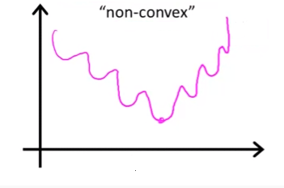
Logistic Regression Cost Function
Unfortunately we can’t use the cost function MSE in logistic regression. It’s because our prediction function is non-linear (due to sigmoid transform).
Squaring this prediction as we do in MSE results in a non-convex function with many local minimums. If our cost function has many local minimums, gradient descent may not find the optimal global minimum.

Slide 12
Logistic Regression Cost Function
Given the training set
we want
For logistic regression, we use following loss function or error function
In case y=1, the output (the cost to pay) approaches to 0 as approaches to 1. Conversely, the cost to pay grows to infinity as approaches to 0.

Slide 13
Logistic Regression Cost Function
This is a desirable property: we want a bigger penalty as the algorithm predicts something far away from the actual value. the same intuition applies when y=0.
Thus, cost function for Logistic regression is given as:

Slide 14
Logistic Regression GD/Derivatives

Slide 15
Logistic Regression GD/Derivatives

Slide 16
Logistic Regression
Thus, parameters of Logistic Regression are updated as below:

Slide 17
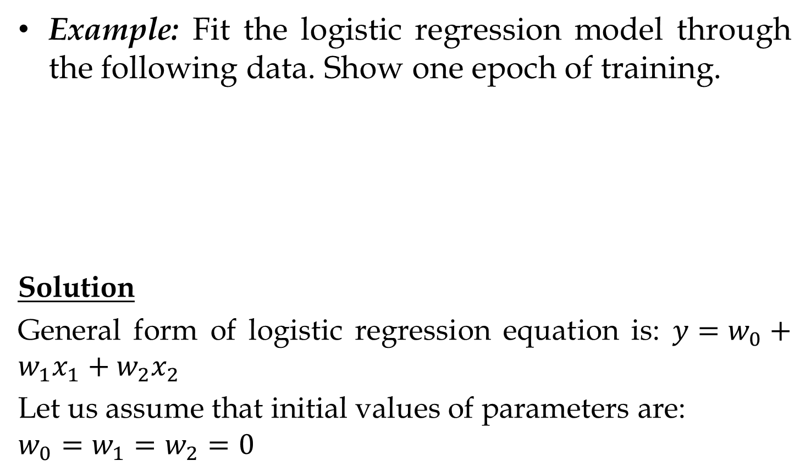
Logistic Regression
Example: Fit the logistic regression model through the following data. Show one epoch of training.
Solution
General form of logistic regression equation is: $y=w_{0}+w_{1}x_{1}+w_{2}x_{2}$
Let us assume that initial values of parameters are:
$$w_{0}=w_{1}=w_{2}=0$$
x₁ | x₂ | Class(y)
0.78 | 0.69 | 1
0.67 | 1.00 | 1
0.00 | 0.00 | 0
0.22 | 0.14 | 0

Slide 18
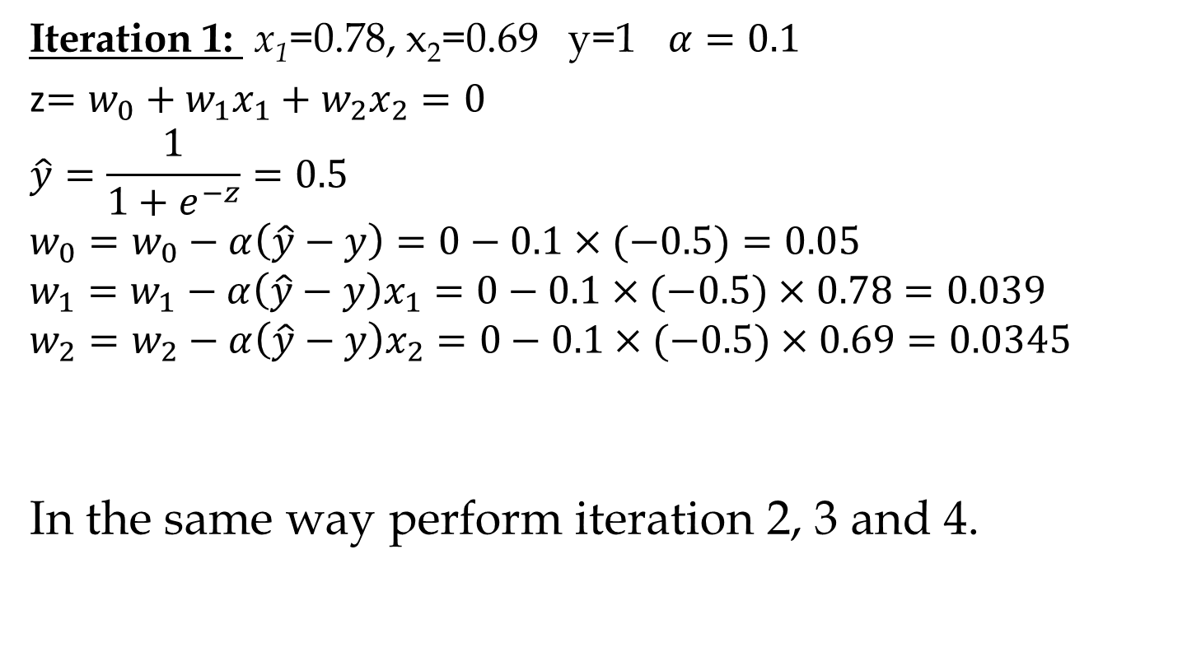
Logistic Regression
Iteration 1: x₁=0.78, x₂=0.69 y=1 $α=0.1$
z$=w_{0}+w_{1}x_{1}+w_{2}x_{2}=0$
$$\hat{y}=\frac{1}{1+e^{−z}}=0.5$$
$$w_{0}=w_{0}−α\left(\hat{y}−y\right)=0−0.1×(−0.5)=0.05$$
$$w_{1}=w_{1}−α\left(\hat{y}−y\right)x_{1}=0−0.1×(−0.5)×0.78=0.039$$
$$w_{2}=w_{2}−α\left(\hat{y}−y\right)x_{2}=0−0.1×(−0.5)×0.69=0.0345$$
In the same way perform iteration 2, 3 and 4.

Slide 19
Linear Basis Function Models
Given a supervised learning problem of using inputs p to predict a continuous target y, the simplest model to use would be linear regression.
However, what if we know that the relationship between the inputs and the target is non-linear, but we are unsure of exactly what form this relationship has?
One way to overcome this problem is to use linear basis function models. These models assume that the target is a linear combination of a set of p+1 basis functions.

Slide 20
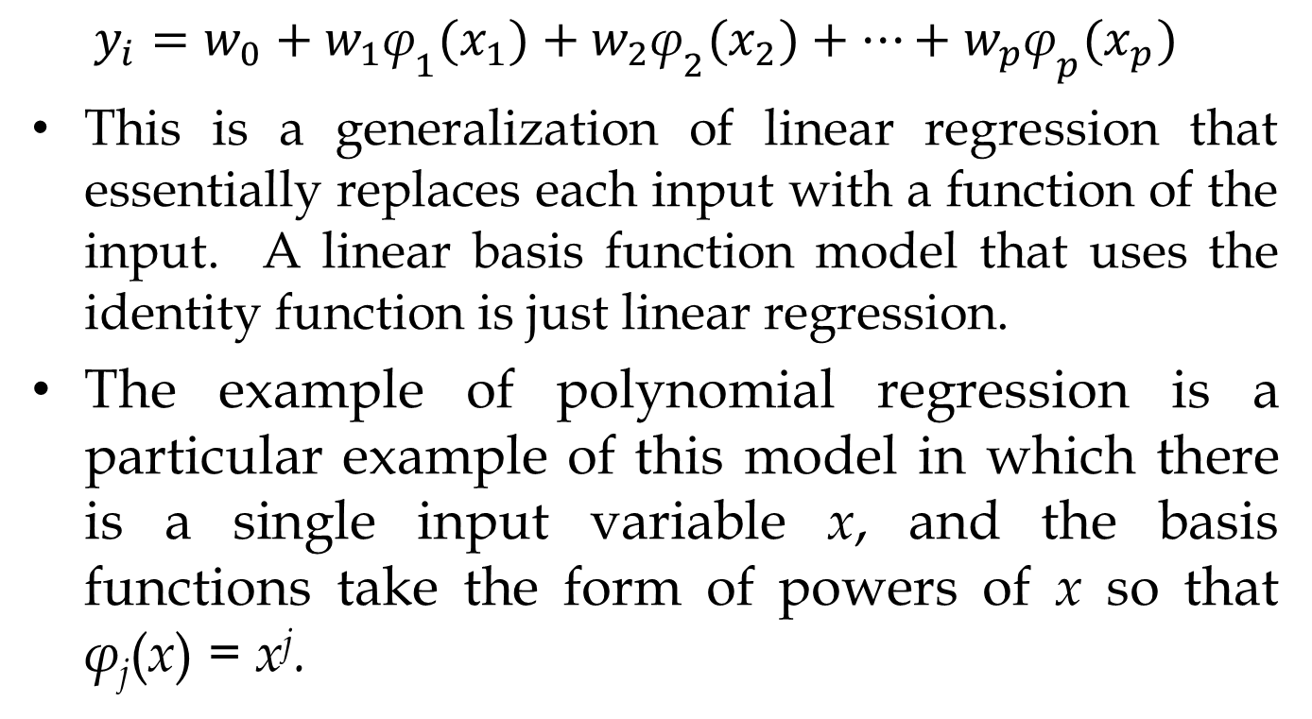
Linear Basis Function Models
$$y_{i}=w_{0}+w_{1}{\text{φ}}_{1}(x_{1})+w_{2}{\text{φ}}_{2}(x_{2})+…+w_{p}{\text{φ}}_{p}(x_{p})$$
This is a generalization of linear regression that essentially replaces each input with a function of the input. A linear basis function model that uses the identity function is just linear regression.
The example of polynomial regression is a particular example of this model in which there is a single input variable x, and the basis functions take the form of powers of x so that φ_{j}(x) = x^{j}.

Slide 21
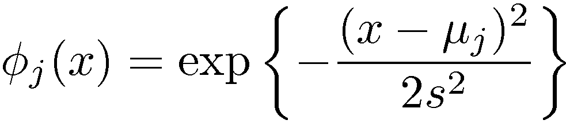
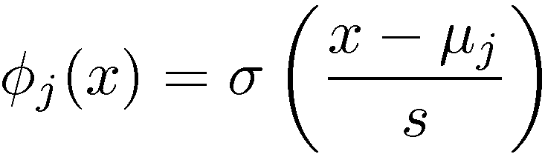
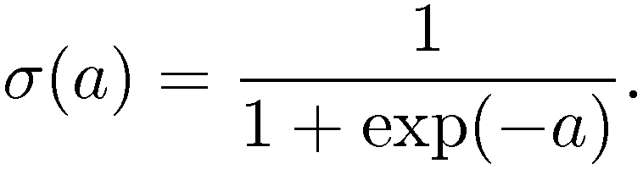
Linear Basis Function Models
There are many other possible choices for the basis functions, for example.
Gaussian basis functions:
Sigmoidal basis functions:
Where,

